Slide 1
Asynchronous Conversation Patterns
Ian Cooper

Slide 2
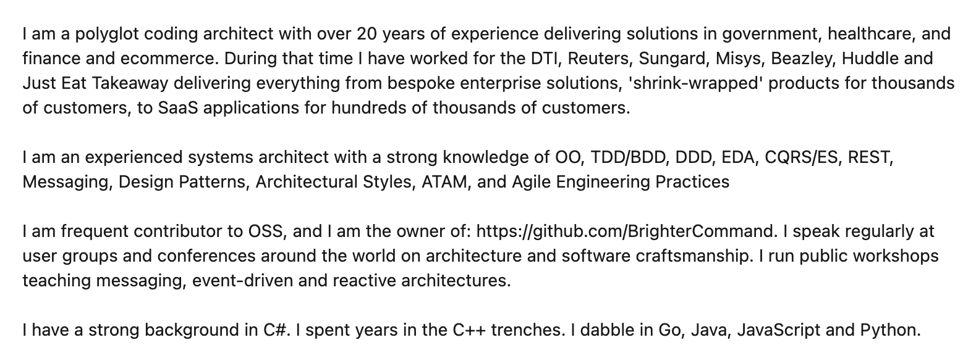
Who are you?
www.linkedin.com/in/ian-cooper-2b059b

Slide 3
Agenda
Messaging & Eventing
Activity
Repair and Clarification
Conversations

Slide 4
Messaging & Eventing
5
Going beyond integration patterns

Slide 5
Messaging Participants
Messaging
Activity
Repair and Clarification
Conversations
A message has a header (metadata) and a body (data)
An application acts as either a producer or consumer
1.1 message()
:producer
:consumer
A message is sent over a channel which is a virtual pipe i.e. topic, routing key
A channel is unidirectional (one way)
Notes:
The problem with using producer and consumer is that the consumer of the message might be the one exposing operations: i.e. receiving a command, or the producer of the API might be the one exposing operations i.e. sending a notification. By thinking instead about requestor and producer we make the role clearer => are you providing the API or using it.

Slide 6
Messaging Participants
Messaging
Activity
Repair and Clarification
Conversations
A request has a header (metadata) and a body (data)
An application acts as either a requestor or provider
1.1 request()
:requestor
:provider
Prefer Requestor and Provider better than Producer/Consumer for conversation patterns because they indicate role.
A request is sent over a channel which is a virtual pipe i.e. topic, routing key
A channel is unidirectional (one way)
Notes:
The problem with using producer and consumer is that the consumer of the message might be the one exposing operations: i.e. receiving a command, or the producer of the API might be the one exposing operations i.e. sending a notification. By thinking instead about requestor and producer we make the role clearer => are you providing the API or using it.

Slide 7
Messaging Participants
Messaging
Activity
Repair and Clarification
Conversations
Requestor: Registers a store and optimizes for a fast lookup on key search terms
Message indicating new store details
1.1 changedstore()
: Search
: Store Information
Provider:
Manages stores for our ecommerce site

Slide 8
In-Only (Fire and Forget) – Consumer As Provider
Messaging
Activity
Repair and Clarification
Conversations
Typically we call this fire-and-forget.
Under a In-Only pattern the requestor sends a request to the provider, but does not seek an acknowledgment of completion of the requested operation
1.1 request()
:requestor
:provider

Slide 9
In-Only (Fire and Forget)
Messaging
Activity
Repair and Clarification
Conversations
Requestor: Has a paid for basket it wants to turn into an order
Typically fire and forget is used where we are finished with our part in a flow, and transferring control. We need no response as we are done..
1.1 place order()
:cashier
:order placement
Provider:
Raises an Order

Slide 10
Out-Only (Notification) - Producer As Provider
Messaging
Activity
Repair and Clarification
Conversations
Under an Out-Only pattern the requestor subscribes to the provider, and an operation is triggered by receipt of a message but it does not acknowledge the message to the provider.
Typically we call this a notification.
1.1 message()
:requestor
:provider

Slide 11
Out-Only (Publish-Subscribe)
Messaging
Activity
Repair and Clarification
Conversations
Registers a store and optimizes for a fast lookup on key search terms
Notification indicating new store details
:Search
1.1 changedstore()
Registers all factors for determining if a store is open for business
Manages stores for our ecommerce site
:Availability
:Store Information
Out-Only is the Publish-Subscribe pattern; a producer is not aware of its consumers; the notification has loose coupling
:Pick-Up Locations
Registers where couriers may need to pick up and restrictions

Slide 12
In-Out (Request-Response) – Both Consumer and Producer
Messaging
Activity
Repair and Clarification
Conversations
Under an In-Out pattern the provider receives a request from the requestor, and returns a response from the operation triggered by that message.
1.1 request()
:requestor
:provider
1.2 response()

Slide 13
Request-Response (Command-Acknowledgement)
Messaging
Activity
Repair and Clarification
Conversations
Operation: Takes payment for the agreed amount and turns a basket into an order
Command: asking checkout for the operation to price a basket
Manages items for purchase by a customer of our ecommerce site
1.1 checkout()
:Basket
:Cashier
1.2 successfulpayment()
In-Out can support the Request-Response or Command-Acknowledgement pattern; a requestor triggers an operation on the provider and gets a response
Response: indicating the basket has been paid for
Notes:
it has behavioural (or control) coupling

Slide 14
In-Out (Query-Result)
Messaging
Activity
Repair and Clarification
Conversations
Operation: Determines the delivery fee based on store and items in the basket
Manages items for purchase by a customer of our ecommerce site
Query asking for delivery fees for this basket
1.1 getdeliveryfees()
:Basket
:Delivery
1.2 deliverfee()
In-Out can support the Query-Result pattern; a requestor triggers a query on the provider and gets a result
Result indicating the fee for the current state of the basket
Notes:
it has behavioural (or control) coupling

Slide 15
Out-In (Solicit-Response) - Both Consumer and Producer
Messaging
Activity
Repair and Clarification
Conversations
Under an Out-In pattern a provider solicits a response from a subscriber, and await a confirmation
1.1 solicit()
:requestor
:provider
1.2 response()
Under an Out-In pattern the subscriber confirms receipt of the provider’s solicitation

Slide 16
Out-In (Solicit-Response)
Messaging
Activity
Repair and Clarification
Conversations
Query to see if a courier is available to receive orders for delivery; usually Delivery service will follow with notifications of available work.
Delivery service assigns delivery request to drivers
1.1 solicit()
:Courier
:Delivery
1.2 ready()
Courier offers jobs depending on location and busyness

Slide 17
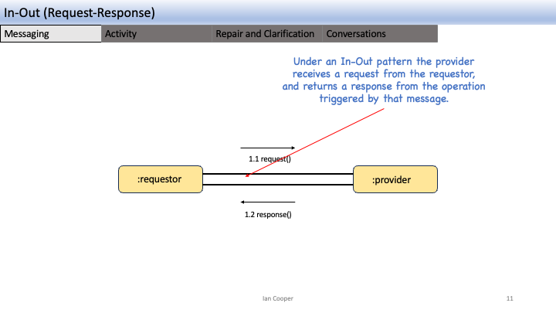
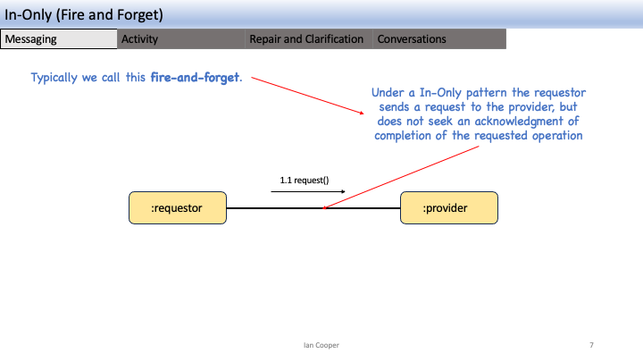
Messaging
Messaging
Activity
Repair and Clarification
Conversations
Messaging
Has Intent
Request An Answer (Query)
Transfer of Control
(Command)
Transfer of Value
Part of a Workflow
Part of a Conversation
Concerned with the Future

Slide 18
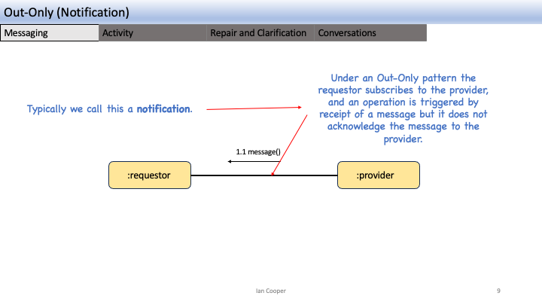
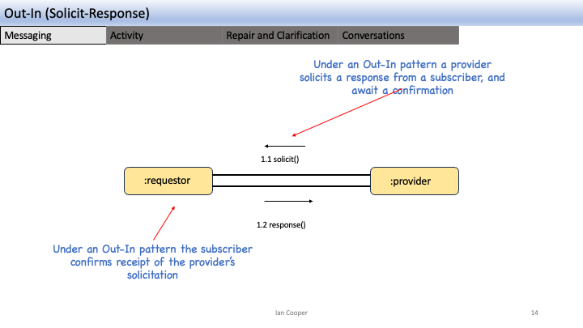
Eventing
Messaging
Activity
Repair and Clarification
Conversations
Eventing
Provides Facts
Things you Report On
No Expectations
History
Context
Concerned with the Past

Slide 19
Activity
15
How do we manage workflows in requestors and providers

Slide 20
In-Only (Fire and Forget)
Messaging
Activity
Repair and Clarification
Conversations
1.1 request()
:requestor
:provider
Because we are fire-and-forget there is no need to maintain state to correlate with a response; we don’t expect a response

Slide 21
Out-Only (Notification)
Messaging
Activity
Repair and Clarification
Conversations
1.1 notification()
:requestor
:provider
Because we only notify there is no need to maintain state to correlate with a response; we don’t expect an acknowledgement

Slide 22
In-Out (Request-Response)
Messaging
Activity
Repair and Clarification
Conversations
Because we expect a response to our request we may need to save state which we then correlate with the request
We may resume a workflow that we suspended, whilst we were waiting for a response
1.1 request()
:requestor
:provider
1.2 response()

Slide 23
In-Out (Request-Response)
Messaging
Activity
Repair and Clarification
Conversations
Because the flow is asynchronous, the requestor enters a waiting for response state – as it cannot complete its own operation until it gets the response
The provider can remain stateless as it only needs to return a response to the requestor
:requestor
:provider
1.1 request()
Waiting for Response
1.2 response()
The requestor must be STATEFUL

Slide 24
In-Out (Request-Response)
Messaging
Activity
Repair and Clarification
Conversations
The requestor can remain stateless by including the state of the conversation within the message it sends
The provider returns the state of the conversation, adjusted for its operation results
:requestor
:consumer
1.1 request()
1.2 response()
The requestor does not need to be STATEFUL, as it just obtains the state of the conversation from the message
N.B. in HTTP this idea becomes HATEOAS

Slide 25
Activity
Messaging
Activity
Repair and Clarification
Conversations
:cashier
An activity is the code that runs in response to receiving a message.
1.2*: get pricing details()
:pricer
Waiting for Response
1.3*: item price()
An activity also stores the state associated with the activity – what did we do in our last turn?
1.4*: take payment()
:payment provider
An activity also knows the messages that is has sent and received, so it can be reconstructed.
Waiting for Response
1.5*: payment taken()

Slide 26
Activity
Messaging
Activity
Repair and Clarification
Conversations
:cashier
:payment provider
An activity is the code that runs in response to sending a message.
1.4*: take payment()
Waiting for Response
An activity may store state associated with the activity – but also may be stateless.
1.5*: payment taken()
Each activity also knows the messages that is has sent and received, so the conversation can be reconstructed.
Waiting for Response

Slide 27
Other Activity State
Messaging
Activity
Repair and Clarification
Conversations
A provider that has subscribers may solicit responses from them; this requires keeping track of those subscribers to correlate the responses.
1.1 solicit()
:requestor
:provider
1.2 response()
Under an Out-In pattern a provider solicits a response from a subscriber, and await a confirmation

Slide 28
Repair and Clarification
25
What happens when it all goes wrong

Slide 29
Failure
Messaging
Activity
Repair and Clarification
Conversations
Failure Scenarios
Loss of messages, out of order messages, incorrect message schema, loss of broker - a distributed system can fail in many ways.
1.1 message()
:requestor
:provider
1.2 acknowledge()
Availability is Latency
We achieve availability by temporal decoupling but this implies that we must cope with latency, even without failure.
Consistency
How can we know that a consumer received a message or processed it?

Slide 30
Failure
Messaging
Activity
Repair and Clarification
Conversations
What happens if we can’t take payment, does it matter if that is because of
What happens if we fail to send the checkout message?
1.1 checkout()
:Basket
:Cashier
1.2 successfulpayment()

Slide 31
Repair and Clarification
Messaging
Activity
Repair and Clarification
Conversations
The requestor triggers an operation on the provider by sending it a message
We need to consider the possibility of a fault being triggered by the operation triggered by the message.
1.1 request()
:requestor
:provider
What guarantees does the provider make to the requestor about communicating any faults that are triggered?

Slide 32
No Fault
Messaging
Activity
Repair and Clarification
Conversations
From the requestor’s perspective, faults are an application issue for the provider, and not its concern
1.1 request()
:requestor
:provider
Under a No Fault pattern the provider makes no attempt to communicate triggered faults from the operation to the requestor

Slide 33
No Fault
Messaging
Activity
Repair and Clarification
Conversations
Most likely we fix consistency issues out-of-band via logs or error reports.
1.1 changedstore()
: Store Information
:Search
We make no attempt to indicate to Store Information that we cannot add a store to our search results
Notes:
This is “good enough” in many cases.

Slide 34
Message Triggers Fault
Messaging
Activity
Repair and Clarification
Conversations
Assumption here is that the requestor can take action on receipt of the fault; but does not normally take a response.
Under Message Triggers Fault pattern a provider propagates triggered faults from the operation back to the requestor that triggered the operation via a message
1.1 request()
:requestor
:provider
1.2 fault()
The message must have the opposite direction and go back to the requestor
Notes:
The key here is that there is no existing subsequent message to replace with a fault, but we still want to communicate faults back

Slide 35
Message Triggers Fault (Robust In-Only)
Messaging
Activity
Repair and Clarification
Conversations
If Order Placement cannot place the order due to a fault we may raise an error
1.1 place order()
:cashier
:order placement
1.2 fault()
The requestor does not need to acknowledge success, but on a fault may need to take other action such as a refund

Slide 36
Message Triggers Fault (Robust Out-Only)
Messaging
Activity
Repair and Clarification
Conversations
If Search cannot add add a store to its db due to a fault we may raise an error back to the store information.
1.1 changedstore()
: Search
: Store Information
1.2 fault()

Slide 37
Fault Replaces Message
Messaging
Activity
Repair and Clarification
Conversations
Under the Fault Replaces Message pattern a provider propagates faults triggered by an operation by switching to a fault flow, replacing any message subsequent to the first with a fault.
1.1 request()
:requestor
:provider
1.2 fault()
1.2 response()
The requestor can handle the error; the error replaces the existing response
Notes:
The key to understanding this is that any message in the conversation, between these two components, after the first, may indicate a fault instead of the normal outcome

Slide 38
Fault Replaces Message (Robust In-Out)
Messaging
Activity
Repair and Clarification
Conversations
Assumption here is that the pricer can orchestrate a new flow, such as asking for an alternate payment method, or cancel the order.
Under Fault Replaces Message pattern the payment provider would signal errors taking a card payment back to the pricer
1.1* take payment()
:pricer
:payment provider
1.3 payment error()
The message should indicate why the payment failed. This might be an issue with the payment provider but it also might be an issue like an invalid card or insufficient funds

Slide 39

In-Out-Retry
Messaging
Activity
Repair and Clarification
Conversations
The producer may not receive an expected response from a consumer. What can it do?
The producer can set a timeout within which to receive a response.
1.1 greet()
:producer
:consumer
1.2 greet()
1.3 acknowledge()
The producer can choose to retry if it does not receive a response within that time window.
Because we might send a message twice, the operation on the consumer must be idempotent, or the consumer must de-duplicate already seen messages

Slide 40
Transactional Messaging (Outbox)
Messaging
Activity
Repair and Clarification
Conversations
:pricer
1.4* take payment()
Transaction Boundary
:payment provider
1.2: store pricing state()
Waiting for Response
1.5*: payment taken()
:pricingState
1.2: store sent message()
To ensure the activity state matches messages sent, we need to use transactional messaging, an outbox.
:sentMessages
Waiting for Response

Slide 41
Transactional Messaging (Inbox)
Messaging
Activity
Repair and Clarification
Conversations
1.4* take payment()
:payment provider
:pricer
To ensure that we have not already processed a message, we use a store of seen messages, an inbox.
1.2: lookup message()
Waiting for Response
1.4: lookup message()
:receivedMessages
Waiting for Response

Slide 42
Conversations
35

Slide 43
Turn Taking
Messaging
Activity
Repair and Clarification
Conversations
Turn-taking consists of a set of in-out pairs
:requestor
:provider
1.1 request ()
1.2 response()
1.3 request()
1.4 response()
As each participant takes its turn, it takes control of the flow

Slide 44
Turn Taking
Messaging
Activity
Repair and Clarification
Conversations
Activity (Internal State)
:requestor
:provider
1.1 request ()
1.2 response()
1.3 request()
1.4 response()
Conversation State

Slide 45
Turn Taking
Messaging
Activity
Repair and Clarification
Conversations
Orchestration: turn taking implies causality, and by implication the requestor’s activity orchestrates the conversation with the provider.
:requestor
:provider
1.1 request ()
1.2 response()
1.3 request()
1.4 response()
Smart Endpoints, Dumb Pipes: we don’t need a process manager/saga, as we can use turn-taking instead

Slide 46
Turn Taking
Conversations
Repair and Clarification
Monologues
Conversations
Choreography
:cart
1.1 reserve seats()
:seating
:payment
1.2 locked seats()
1.3 purchase seats()
1.5 confirm seat()
1.4 confirm purchase()
1.6 allocate seat()
Orchestration

Slide 47
Routing Slip
Conversations
Repair and Clarification
Monologues
Conversations
The requestor can choose the steps in the Routing Slip, and thus the flow. The point of the Routing Slip though is that the steps do not then make routing choices, but stick to the planned route.
The request is a Routing Slip, which contains the steps of the workflow. Normally these are the (topics) that the message should be forwarded to and an indicator a step is complete
:provider
1.1 request()
:requestor
1.2 request()
Process Request
:provider
1.2 request()
Routing Slip
Route to next recipient
:provider
Steps[1..n]
getNextStep(): String

Slide 48
Routing Slip
Conversations
Repair and Clarification
Monologues
Conversations
Orchestration
:provider
1.1 request()
:requestor
1.2 request()
Process Request
:provider
1.2 request()
Route to next recipient
:provider

Slide 49
Process Manager (Saga)
Conversations
Repair and Clarification
Monologues
Conversations
The requestor provides the delivery and pickup address, size, weights etc of the order
1.3 request()
:requestor
:provider
1.4 reaction()
1.5 request()
:provider
1.6 reaction()
1.7 request()
:provider
1.8 reaction()
1.2 read()
1.1 write()
:workflowStore

Slide 50
Process Manager (Saga)
Conversations
Repair and Clarification
Monologues
Conversations
Orchestration
1.3 request()
:requestor
:provider
1.4 reaction()
1.5 request()
:provider
1.6 reaction()
1.7 request()
:provider
1.8 reaction()
1.2 read()
1.1 write()
:workflowStore

Slide 51
Conversation Types
Conversations
Repair and Clarification
Monologues
Conversations
Turn Taking | Routing Slip | Process Manager (Saga)
Complex Flow | Simple Flow | Complex Flow
Rigid Flow | Dynamic Flow | Dynamic Flow
No central point of failure | No central point of failure | Central point of failure
Distributed | Distributed | Hub-and-Spoke
No central administration or reporting | Central administration but not reporting | Central Administration and Reporting

Slide 52
Q&A
40

